Slide 1
BIG DATA – HADOOP AND COMPONENTS
BY:
DEEPIKA DHANAJAYAN

Slide 2
Big data
Big data is data sets that are so big and complex that traditional data-processing application software are inadequate to deal with them.
Big data challenges include capturing data, data storage, data analysis, search, sharing, transfer, visualization, querying, updating and information privacy.
Big Data is a phrase used to mean a massive volume of both structured and unstructured data
Big Data has the potential to help companies improve operations and make faster, more intelligent decisions.
Quite simply, big data reflects the changing world we live in. The more things change, the more the changes are captured and recorded as data.

Slide 3
CHARACTERISTIC OF BIG DATA
The concept gained momentum in the early 2000s when industry analyst Doug Laney articulated the now-mainstream definition of big data as the three Vs:
Volume
Velocity
Variety
Two additional dimensions are added in later stage:
Variability
Veracity

Slide 4
5Vs
Volume:
The quantity of generated and stored data. The size of the data determines the value and potential insight- and whether it can actually be considered big data or not.
Variety:
The type and nature of the data. This helps people who analyze it to effectively use the resulting insight.
Velocity:
In this context, the speed at which the data is generated and processed to meet the demands and challenges that lie in the path of growth and development.
Variability:
Inconsistency of the data set can hamper processes to handle and manage it. Changing data and changing model.
Veracity:
The quality of captured data can vary greatly, affecting the accurate analysis.

Slide 5
ADVANTAGES AND BENEFITS
Big Data is timely
Big Data is accessible
Big Data is holistic
Big Data is secure
Big Data is Relevant
Big Data is actionable
Cost Reduction
Faster

Slide 6
SECTORS USING BIG DATA
Banking
Education
Government
Health Care
Manufacturing
Retail
Finance
Media
Information Technologies
and more or less everywhere…

Slide 7

Hadoop is an Apache open source framework written in java that allows distributed processing of large datasets across clusters of computers using simple programming models.
A Hadoop frame-worked application works in an environment that provides distributed storage and computation across clusters of computers.
Hadoop is designed to scale up from single server to thousands of machines, each offering local computation and storage.

Slide 8
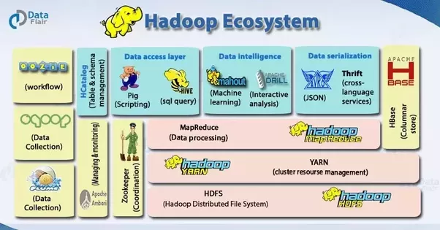
HADOOP - ECOSYSTEM

Slide 9
Hadoop-related projects at Apache include:
HBase:
A scalable, distributed database that supports structured data storage for large tables.
Hive:
A data warehouse infrastructure that provides data summarization and ad hoc querying.
Pig:
A high-level data-flow language and execution framework for parallel computation.
Flume:
A distributed, reliable, and available service for efficiently collecting, aggregating, and moving large amounts of streaming event data.
ZooKeeper:
A high-performance coordination service for distributed applications.

Slide 10
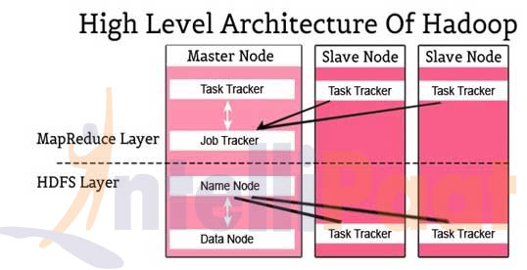
HADOOP ARCHITECTURE

Slide 11
Apache Hadoop Module
Hadoop Common:
Includes the common utilities which supports the other Hadoop modules
HDFS:
Hadoop Distributed File System provides unrestricted, high-speed access to the data application.
Hadoop YARN
This technology is basically used for scheduling of job and efficient management of the cluster resource.
MapReduce:
This is a highly efficient methodology for parallel processing of huge volumes of data.

Slide 12
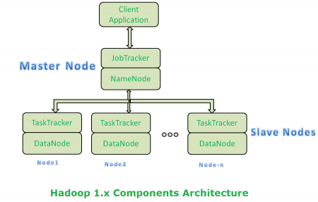
Architecture 1.X

Slide 13
Limitations of Architecture 1.x
It is only suitable for Batch Processing of Huge amount of Data, which is already in Hadoop System.
It is not suitable for Real-time Data Processing and data Streaming.
It supports up to 4000 Nodes per Cluster.
It has a single component : Job Tracker to perform many activities like Resource Management, Job Scheduling, Job Monitoring, Re-scheduling Jobs etc.
Job Tracker is the single point of failure.
It does not support Multi-tenancy Support.
It supports only one Name Node and One Namespace per Cluster.
It runs only Map/Reduce jobs.
It follows Slots concept in HDFS to allocate Resources (Memory, RAM, CPU). It has static Map and Reduce Slots. That means once it assigns resources to Map/Reduce jobs, it cannot re-use them even though some slots are idle.

Slide 14
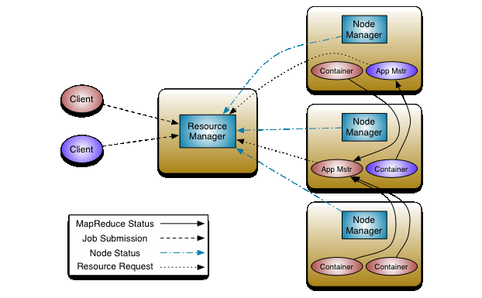
Architecture 2.x

Slide 15
Hadoop 2.x YARN Benefits
Highly Scalability
Highly Availability
Supports Multiple Programming Models
Supports Multi-Tenancy
Supports Multiple Namespaces
Improved Cluster Utilization
Supports Horizontal Scalability

Slide 16
HDFS (Hadoop Distributed File System)
HDFS is the primary distributed storage used by Hadoop applications.
A HDFS cluster primarily consists of a Name Node that manages the file system metadata and Data Nodes that store the actual data.
Clients contact Name Node for file metadata or file modifications and perform actual file I/O directly with the Data Nodes.
Hadoop, including HDFS, is well suited for distributed storage and distributed processing using commodity hardware.
It is fault tolerant, scalable, and extremely simple to expand.

Slide 17
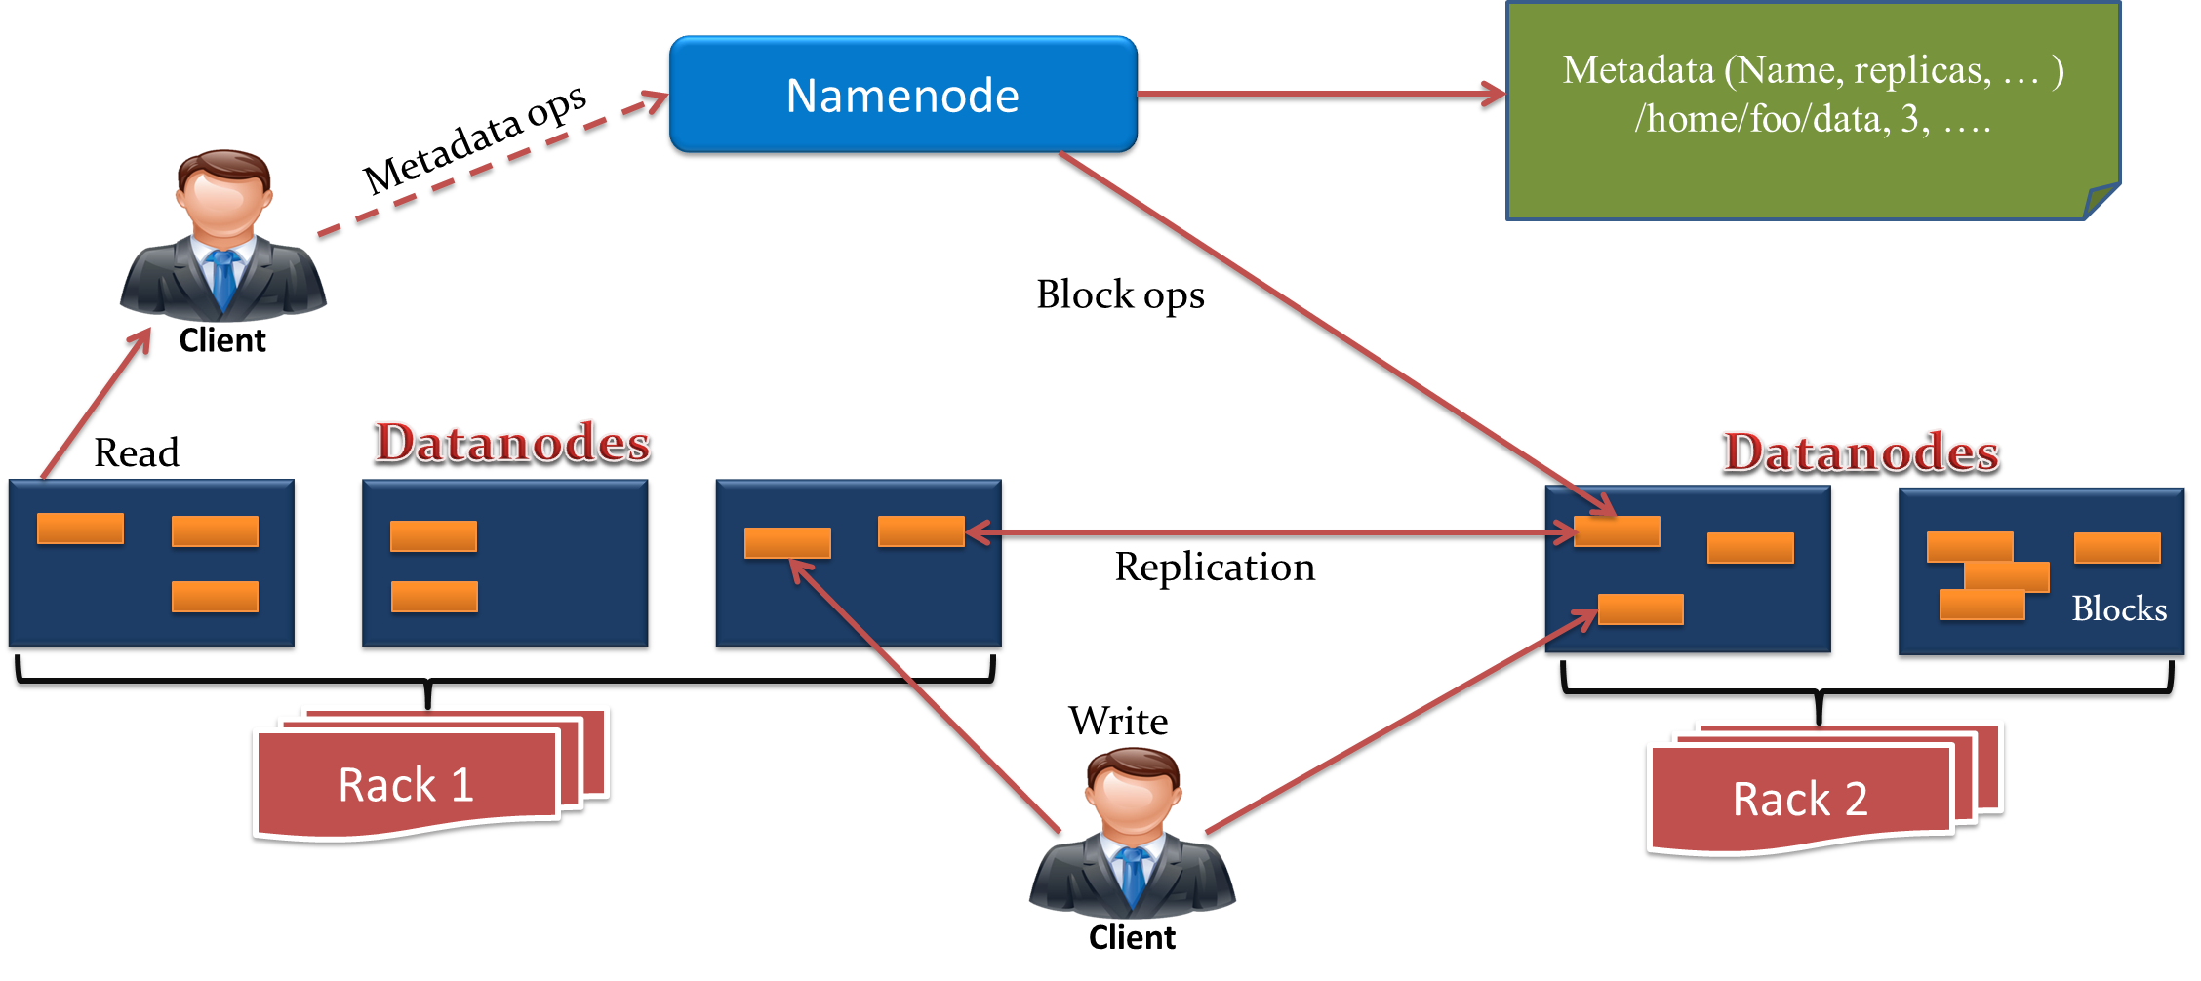
HDFS Architecture

Slide 18
Name Node and Data Node
HDFS has a master/slave architecture.
An HDFS cluster consists of a single Name Node, a master server that manages the file system namespace and regulates access to files by clients. In addition, there are a number of Data Nodes, usually one per node in the cluster, which manage storage attached to the nodes that they run on.
The Name Node executes file system namespace operations like opening, closing, and renaming files and directories. It also determines the mapping of blocks to Data Nodes. The Name Node is the arbitrator and repository for all HDFS metadata.
The Data Nodes are responsible for serving read and write requests from the file system’s clients. The Data Nodes also perform block creation, deletion, and replication upon instruction from the Name Node.

Slide 19
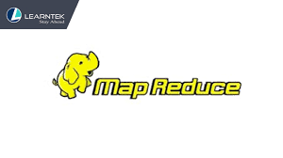
MAPREDUCE
Mapreduce is mainly a data processing component of Hadoop.
It is a programming model for processing large number of data sets. It contains the task of data processing and distributes the particular tasks across the nodes. It consists of two phases –
Map
Reduce
Map converts a typical dataset into another set of data where individual elements are divided into key/value pairs.
Reduce task takes the output files from a map considering as an input and then integrate the data tuples into a smaller set of tuples. Always it is been executed after the map job is done.

Slide 20
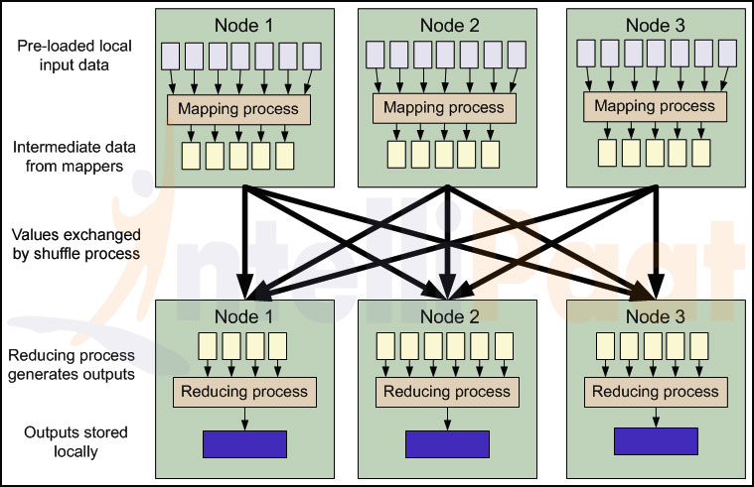
MapReduce Architecture

Slide 21
MapReduce Classes
Mapper: Mapper maps input key/value pairs to a set of intermediate key/value pairs. The Hadoop Map Reduce framework spawns one map task for each Input Split generated by the Input Format for the job.
Reducer: Reducer reduces a set of intermediate values which share a key to a smaller set of values. The number of reduces for the job is set by the user via Job.setNumReduceTasks(int).
Combiner: A Combiner, also known as a semi-reducer, is an optional class that operates by accepting the inputs from the Map class and thereafter passing the output key-value pairs to the Reducer class. The main function of a Combiner is to summarize the map output records with the same key. The output (key-value collection) of the combiner will be sent over the network to the actual Reducer task as input.
Partitioner: Partitioner controls the partitioning of the keys of the intermediate map-outputs. The key (or a subset of the key) is used to derive the partition, typically by a hash function.

Slide 22

HIVE
Hive is a data warehouse infrastructure tool to process structured data in Hadoop. It resides on top of Hadoop to summarize Big Data, and makes querying and analyzing easy.
Initially Hive was developed by Facebook, later the Apache Software Foundation took it up and developed it further as an open source under the name Apache Hive. It is used by different companies. For example, Amazon uses it in Amazon Elastic MapReduce.
Hive is not
A relational database
A design for OnLine Transaction Processing (OLTP)
A language for real-time queries and row-level updates
Features of Hive
It stores schema in a database and processed data into HDFS.
It is designed for OLAP.
It provides SQL type language for querying called HiveQL or HQL.
It is familiar, fast, scalable, and extensible.

Slide 23

PIG
Apache Pig is a platform for analyzing large data sets that consists of a high-level language for expressing data analysis programs, coupled with infrastructure for evaluating these programs.
The salient property of Pig programs is that their structure is amenable to substantial parallelization, which in turns enables them to handle very large data sets.
Key Properties:
Ease of Programming
Optimization opportunities
Extensibility
Two modes of Pig:
Local Mode
Map reduce Mode

Slide 24

SQOOP
Apache Sqoop is a tool designed for efficiently transferring bulk data between Apache Hadoop and structured datastores such as relational databases.
You can use Sqoop to import data from external structured datastores into Hadoop Distributed File System or related systems like Hive and HBase.
Conversely, Sqoop can be used to extract data from Hadoop and export it to external structured datastores such as relational databases and enterprise data warehouses.

Slide 25

HBASE
Apache HBase is an open-source, distributed, versioned, non-relational database modeled after Google's Bigtable
A Distributed Storage System for Structured Data by Chang et al. Just as Bigtable leverages the distributed data storage provided by the Google File System, Apache HBase provides Bigtable-like capabilities on top of Hadoop and HDFS.
HBase is a type of "NoSQL" database.
HBase is really more a "Data Store" than "Data Base"

Slide 26

ZOOKEEPER
ZooKeeper is a centralized service for maintaining configuration information, naming, providing distributed synchronization, and providing group services. All of these kinds of services are used in some form or another by distributed applications.

Slide 27
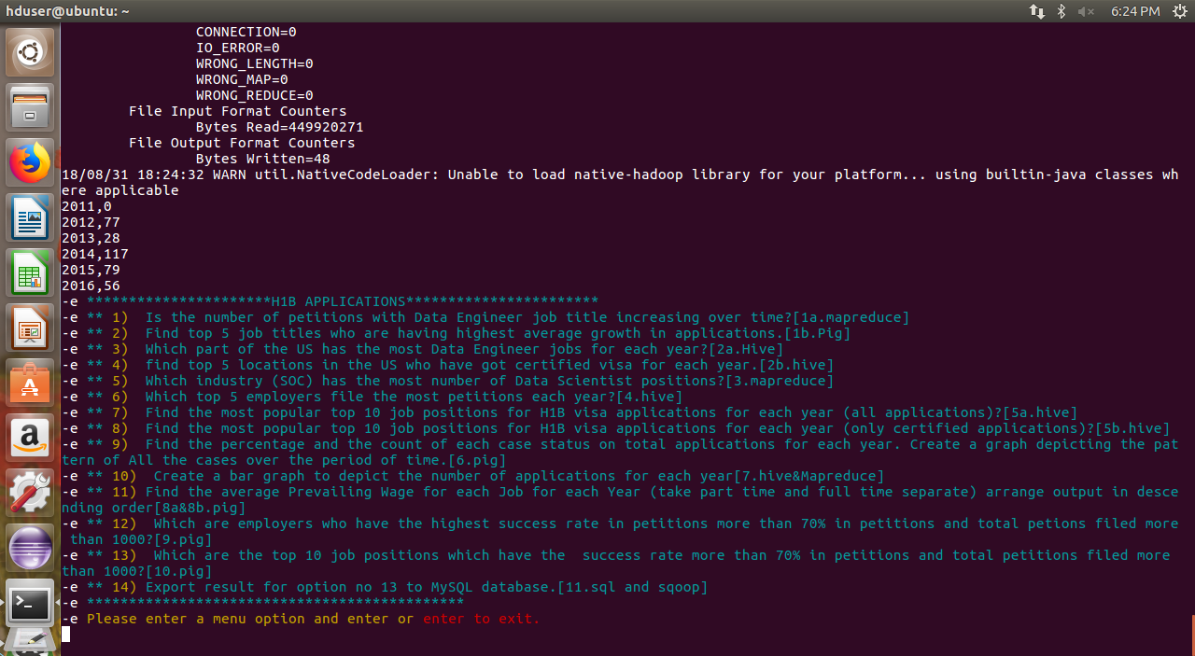
1a. Is the number of petitions with Data Engineer job title increasing over time?

Slide 28
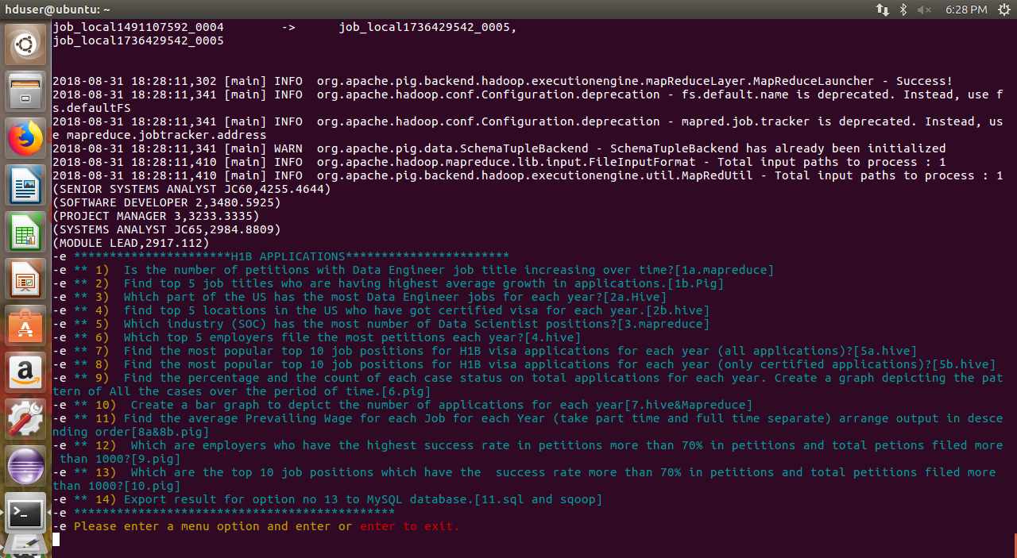
1b. Find top 5 job titles who are having highest avg growth in applications.[ALL]

Slide 29
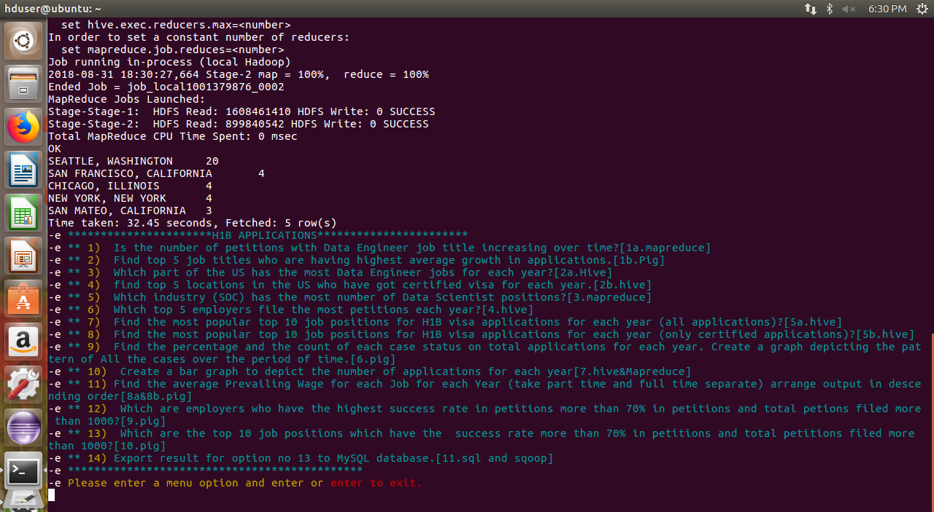
2a. Which part of the US has the most Data Engineer jobs for each year?

Slide 30
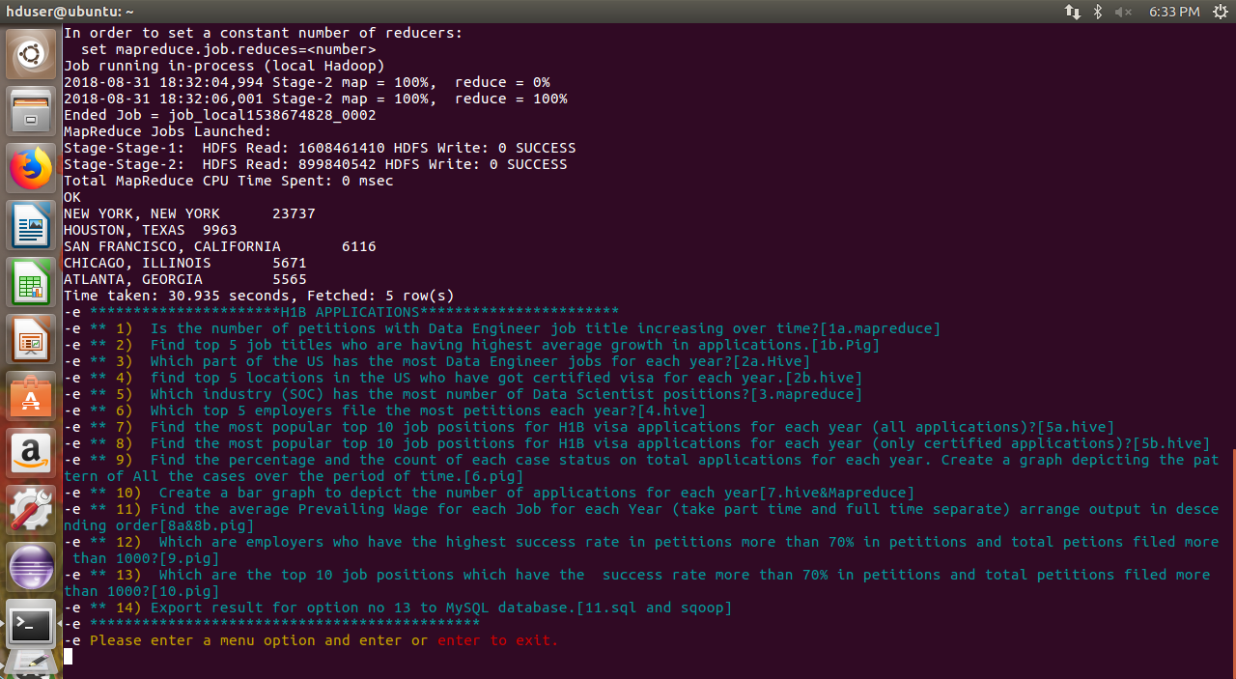
2b. find top 5 locations in the US who have got certified visa for each year.[certified]

Slide 31
THANK YOU

